Slide 1
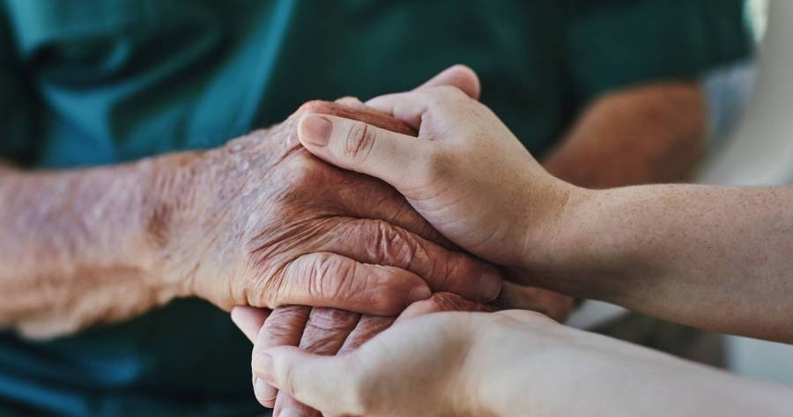
HOLMUSK
Technical task
Molly Grant

Slide 2
major depressive disorder
OBJECTIVE
TARGET GROUP
Generate insights using data to better understand the treatment of major depressive disorder (MDD).
Patients who received mental healthcare for MDD in a major hospital system in Singapore.
What we know
Typically treated with antidepressants and psychotherapy, with combined treatment often more effective (1).
There are disparities in who uses psychotherapy, such as by age and gender (2).
Singapore has a lower psychiatrist-to-population ratio than other developed countries such as the USA, UK, and Australia (3).
Potential disparities in access and utilisation of psychotherapy.

Slide 3
Research question
How do sociodemographic factors influence the utilisation of psychotherapy among patients with MDD?

Slide 4

SAMPLE
Dataset of patients who received mental healthcare for MDD in a major hospital system in Singapore (n = 3,000).
Who are the patients?
Race: 63.8% Chinese, 21.0% Malay, 9.8% Indian, 5.4% Others
Gender: 49.9% female
Age: M = 63.3 years (SD = 14.6)
Resident status: 59.4% Singaporean, 20.3% Citizen,
15.5% PR, 4.8% Foreigner
treatment
99.9% (n = 2,998) received some form of treatment
82.2% (n = 2,465) received psychotherapy
17.8% (n = 533) received medication but not psychotherapy

Slide 5
APPROACH
Process
Variable selection: race, gender, age, residential status, psychotherapy.
Data cleaning (e.g., re-coding, checks for missing data, duplicates).
Analysis
Descriptive statistics (mean, standard deviations, frequencies, percentages).
Chi-square (X²) test:
determine if there are differences in psychotherapy participation across different groups.
p-value <.05 can be interpreted as a significant difference across groups.

Slide 6
FINDINGS
Table. Descriptive statistics for psychotherapy (n = 3,000)
Sociodemographic characteristics | Participation in psychotherapy |  | Chi-square (X²) p-value
 | No % (n) | Yes % (n)
Race |  |  | p > .05
Chinese | 17.49 (335) | 82.51 (1,580)
Malay | 18.44 (116) | 81.56 (513)
Indian | 18.64 (55) | 81.36 (240)
Others | 18.01 (29) | 81.99 (132)
Gender |  |  | p > .05
Female | 16.97 (254) | 83.03 (1,243)
Male | 18.70 (281) | 81.30 (1,222)
Age |  |  | p > .05
Under 45 years | 18.96 (51) | 81.04 (218)
45–60 years | 17.47 (200) | 82.53 (945)
60–75 years | 19.12 (152) | 80.88 (643)
75+ years | 16.69 (132) | 83.31 (659)
Resident status |  |  | p > .05
Singaporean | 17.21 (105) | 82.79 (505)
Citizen | 18.24 (325) | 82.76 (1,457)
PR | 16.56 (77) | 83.44 (388)
Foreigner | 19.58 (28) | 80.42 (115)

Slide 7
interpretation
How do sociodemographic factors influence the utilisation of psychotherapy among patients with MDD?
There appear to be no disparities in the utilisation of psychotherapy across different racial, gender, age, and residential groups.

Slide 8
LIMITATIONS and opportunities
LIMITATIONs
FUTURE WORK
More background information required.
Wider range of demographics (e.g., socioeconomic status).
Other factors (e.g., responsiveness to antidepressents).
Limited generalisibiliy (e.g., race, age).
Limited information about psychotherapy.
Duplicates due to multiple hospital admissions.
ASSUMPTIONS
Singapore
Data reliability
8

Slide 9

SUMMARY
Better understand the treatment MDD.
Examined the influence of sociodemographic factors on patient use of psychotherapy.
Psychotherapy does not appear to be utilised differentially by patients of varied race, gender, age, and residential status.

Slide 10
REFerences
Cuijpers P, Sijbrandij M, Koole SL, Andersson G, Beekman AT, Reynolds III CF. Adding psychotherapy to antidepressant medication in depression and anxiety disorders: A meta-analysis. Focus. 2014 Jul;12(3):347-58.
Leppänen H, Kampman O, Autio R, Karolaakso T, Näppilä T, Rissanen P, Pirkola S. Socioeconomic factors and use of psychotherapy in common mental disorders predisposing to disability pension. BMC Health Services Research. 2022 Aug 1;22(1): 983
Kua EH, Rathi M. Mental health care in Singapore: Current and future challenges. Taiwanese journal of psychiatry. 2019 Jan 1;33(1):6-12.

